Slide 1
Summer research intern
Topic- Brain Computer Interface
IIL lab
L. S. Vishnu Sai Rao

Slide 2
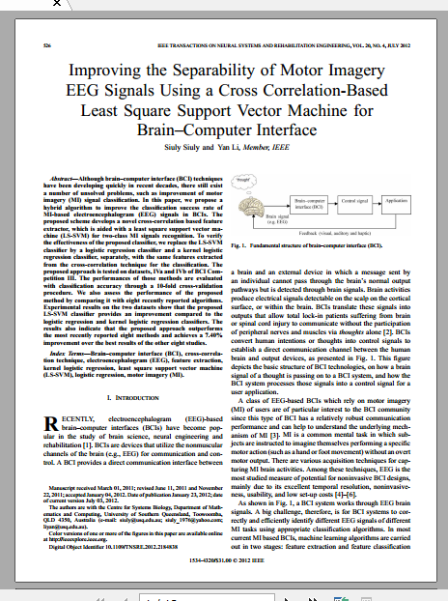
Paper that was implemented
Improving the Separability of Motor Imagery
EEG Signals Using a Cross Correlation-Based
Least Square Support Vector Machine for
Brain–Computer Interface
Siuly Siuly and Yan Li, Member, IEEE

Slide 3
Brief description of paper contents
Used Standard MOTOR IMAGERY based datasets of BCI competition III.
Proposed a novel method of CROSS CORRELATION(as feature extraction technique) and LSSVM( as classification algorithm) in order to improve the accuracy of motor imagery based datasets.
Compared this novel method with existing methods to show that this method would be preferable to others
Also varied the feature vectors number inorder to show a variation in accuracy with number of vectors

Slide 4
Analysis of motor imagery signals is done like this
EEG signals
of two
classes
Feature extraction
Classification using different algorithms
10-fold cross validation
Classification outcomes

Slide 5
Input data format and data processing

Slide 6
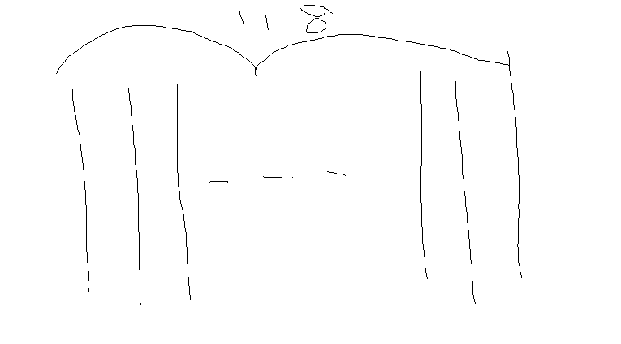
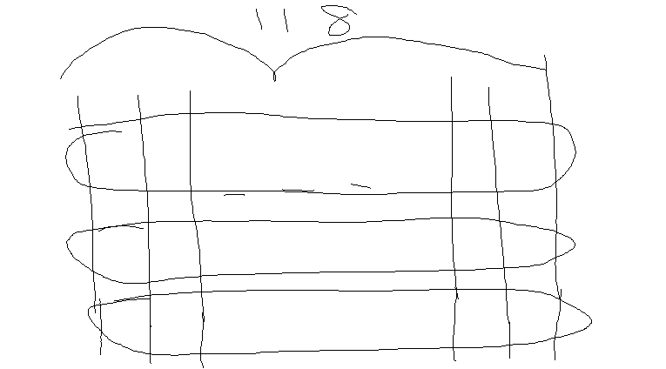
Input data Format Matrix of 118 columns
where each column represent a signal
obtained from a particular channel
Each of the 118 columns had data from both the classes.
This is because of the experimental setup
Class 1
Class 1
Class 2

Slide 7
In machine learning terms there are 236 training examples or samples of which first 118 are class 1 are rest class 2
The matrix of 118 columns has been transformed to matrix of 236 columns where the first 118 describe class 1 only and the rest are class 2 only
Class 1
Class 2
Class 1
Only class 1
Only class 2

Slide 8
Description of cross- correlation feature
One reference signal
EEG signals of two classes
Cross-correlation
Cross-correlograms
Statistical feature extraction
All the non-reference signals
Features used were max, min, mean, mode, median ,std dev, 1/4percentile (first quartile), inter quartile range and 3/4 percentile (third quartile). All these statistical attributes were evaluated using standard MATLAB commands except for mode where a histogram was first computed for the signal and then its peak was chosen as mode.
Reference signals for Motor imagery data
are C3 and Fp1. Each one was used separately
for classification.
Matrix formed at the end of cross correlation has 235 columns because one of the columns is used to cross correlate with all the others

Slide 9
LR
KLR
LS-SVM
Classification algorithms used in the paper

Slide 10
POINTS TO BE NOTED WHILE IMPLEMENTING CLASSIFICATIONS
KLR
KLR has been implemented using the ’minFunc’ software provided by Mark Schmidt. Kernel function was
chosen as radial bias function. The rbf scale was chosen as 1. After evaluating the kernel function , the parametres of the model were evaluated using the ’minFunc’. For testing the data, parametres of the model remain the same, only change is kernel function which is re-evaluated. The new kernel function along with the training parametres was used to predict the output class of the testing data.
LSSVM
The kernel function used for LS-SVM in this study is radial bias function (K(Xi, x) =exp(−(||xi − x||)2/2σ2)). There are two important parameters in LS-SVM which are γ which is the regularisation parameter and σ2 which is a kernel parameter controlling the sensitivity of the kernel. These parametres are determined using a two-step grid search technique .The value of γ and σ2 have to be low so as to avoid overfitting. The evaluated parameters γ and σ2 were used in training in order to find the model parameters. A 10-fold cross-validation was done to measure the classification accuracy
LR
Implemented using matlab functions

Slide 11
Two additional algorithms were added from my side which are
– MLP (multi layer perceptron)
and PNN (probabilistic neural network
The accuracies of LSSVM were still outperforming all the algorithms

Slide 12
POINTS TO BE NOTED WHILE IMPLEMENTING CLASSIFICATIONS
MLP
MLP has been implemented in this study using the Neural Network toolbox present in MATLAB. Training ratio was set as hundred percent because the training and testing dataset
were already pre-determined for cross-validation. The number of hidden layers could be varied and different number of hidden layer yielded different accuracies. The number of hidden layers have been chosen so as to maximise the accuracy.
PNN
Training and testing have been done using the Neural Network toolbox present in MATLAB. RBF was used as a kernel function.
Different kernel parameters resulted in different accuracies,
hence a range from 0.05 to 0.5 was considered and that value
was chosen which resulted in maximum accuracy

Slide 13
Different feature extraction techniques other that cross- correlation were tried in order to improve the accuracy
DWT seemed to give exceptional results even over all the subjects.
Tried combinations of Cross- correlation and DWT but DWT alone seemed to better extract features.
LSSVM still remained best among the classification procedures
Procedure employed to get good results

Slide 14
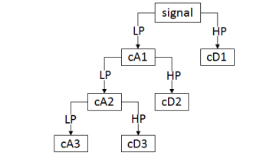
WHATS DWT?
Discrete wavelet transform (DWT) is a feature extraction technique in which signal is decomposed using low pass and high pass filters. The signal is decomposed to yield low frequency contents (approximation coefficients) and high frequency contents (detail coefficient) from a low pass filter and a high pass filter respectively. The approximations are passed again through low pass filter and high pass filter for decomposition into the next level.
Daubechies-4 (db4) decomposition filter has been considered. The other parameter to be
set in DWT is the level of decomposition which depends on the signal and the task to be performed. In this study, signals are decomposed to six levels resulting in six detail coefficients
and one approximation coefficient. Nine features are to be extracted from these coefficients. The first three are variances of the detail coefficients at level 1, 2 and 3. Detail coefficients at level 4, 5 and 6 have been auto correlated. Variance of them was then calculated to give the next three features. The last three features were found by taking the absolute mean of smoothened versions of detail coefficients at level 1, 2 and 3.
No. of columns in the matrix remains the same which is 236. Number of rows are 9 because 9 features are extracted.

Slide 15
Results

Slide 16
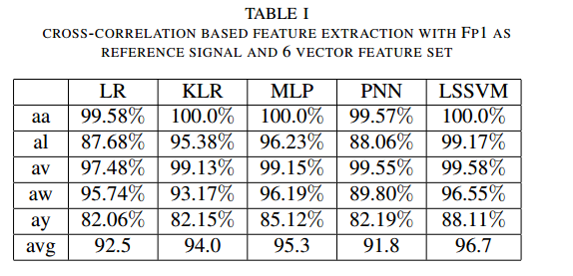
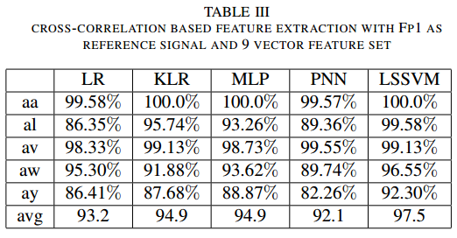
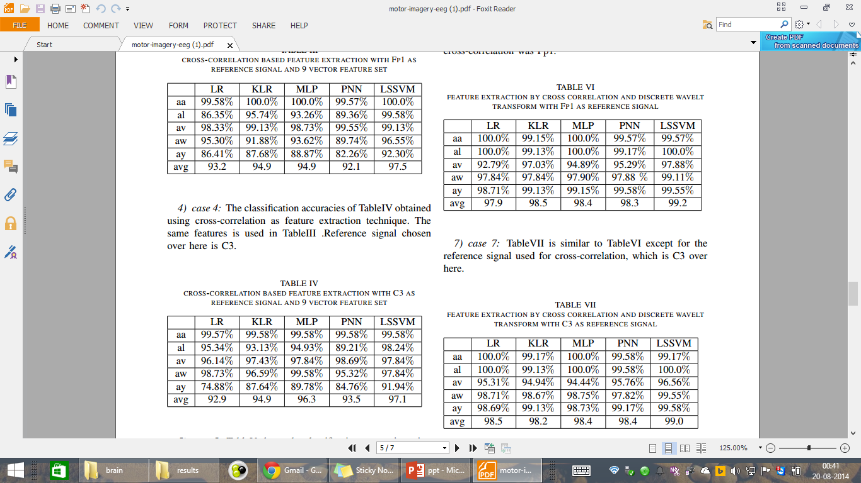
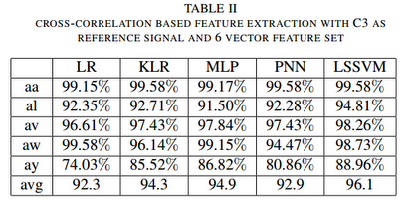

Slide 17
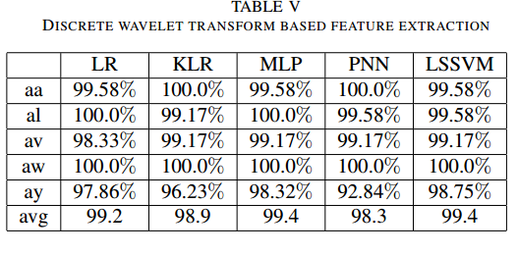

Slide 18
Lab experiment results. Similar manipulations as done with the standard datasets. Used only DWT for feture extraction.
Description:- Done using emotiv device.
An experimental cue was set up in which for first 20 seconds the person had to imagine a particular task say right hand movement. This was followed by a 5 minute delay and then for next 20 secs subject had to imagine another task say right leg movement. The data was then passed to a band pass filter an processed according in the similar way as was done using standard datasets

Slide 19
Subject--srk
Lr | Klr | Pnn
56.506239 +- 7.042690 | 55.392157 +- 4.002269 | 52.076649 +- 7.156942
No. of colums 168*2
Subject-vsr
Lr | Klr | Pnn
53.474265 +- 8.230373 | 56.496212 +- 6.711350 | 57.800245 +- 7.876102
Subject-amr3
Lr | Klr | Pnn
43.135027 +- 8.052774 | 50.678476 +- 8.897294 | 50.679033 +- 7.045883
Subject-sub3
Lr | Klr | Pnn
53.288770 +- 10.791346 | 50.597148 +- 8.039750 | 52.959002 +- 9.225046

Slide 20
Now I have removed some channels from the data because either they were less active or they did not contribute to the motor imagery data. No. of columns in the matrix are 192
Subject--srk
Lr | Klr | Pnn
56.169591 +- 11.938326 | 57.742690 +- 9.392393 | 57.219298 +- 11.498095
Subject-vsr
Lr | Klr | Pnn
57.374269 +- 12.373169 | 52.464912 +- 15.472973 | 54.488304 +- 12.557058

Slide 22
Cross-correlation for two class Motor Imagery EEG signal
One reference signal
EEG signals of two classes
Cross-correlation
Cross-correlograms
Statistical feature extraction
All the non-reference signals

Slide 23
Cross-correlation statistical features extraction
A cross-correlation sequence, denoted is calculated recursively using a reference signal and other non-reference signal using the cross-correlation technique [14]
The graphical presentation of a cross-correlation sequence is called a cross-correlogram.
The reference signal of a class is cross correlated with the data of the remaining signals of this class and the data of all signals of another class.
Study considers six statistical features, mean, median, mode, standard deviation, maximum and minimum as the representatives ideally containing all important information of the original signal patterns.
S. Dutta,et al “An automated hierarchical gait pattern identification tool employing cross-correlation-based feature extraction and recurrent neural network based classification,” Expert Syst., vol. 26, no. 2, 2009.

Slide 24
Cross-correlation statistical features extraction….
These features are calculated from each cross correlation sequence or cross-correlogram to create feature vector sets.
If we have two classes of EEG signals, and class 1 has n signals and class 2 has m signals, and a reference signal is chosen from class 1, then a total of (n-1) cross-correlation sequences are obtained from class 1 and a total of m cross-correlation sequences from class 2.
The six traits of the cross-correlation sequences are found to serve as important indicators of the neurological state of the subjects.

Slide 25
Cross-Validation
10-fold cross-validation method is used for assessing the performance of classifier. This procedure divides the feature vector sets into ten approximately equal-sized distinct partitions[23].
One partition is then used for testing, whilst other partitions are used for training the model.
To further improve the estimate, the procedure is repeated ten times and all accuracy rates over these ten runs are averaged.
The average accuracy over the ten runs obtained from the test data is taken as the performance evaluation criteria in this study

Slide 26
Classification models
Following three type of classification is used for classification
LS-SVM
LR
KLR

Slide 27
Classification by LS-SVM
Least Square-SVM is employed with radial basis function (RBF) kernel as a classifier to distinguish the features obtained from the cross-correlation technique[23-25].
The obtained training feature vector of six dimensions are used as the input to train the LS-SVM classifier and the testing feature vector sets are employed to verify the performance and the effectiveness of the trained LS-SVM for the classification of two-class of EEG signals in the both datasets.
Gamma=500 sigma^2=20 from paper
LS-SVMlab Toolbox (Available: http://www.esat.kuleuven.ac.be/sista/lssvmlab/

Slide 28
Classification using LS-SVM…..
The two important parameters of the LS-SVM are selected by a two-step grid search technique for getting reliable performance of the method[17-19].
Classification using LS-SVM technique is employed using the standard function present in the LS-SVM toolbox
The classification accuracy is measured using the 10 fold cross validation technique
J. A. K. Suykens et.al , Least Square Support Vector Machine. Singapore: World Scientific, 2002

Slide 29
Logistic Regression(LR)
To compare the performance of the proposed LS-SVM classifier, we employ the logistic regression classifier instead of the LS-SVM for the same feature sets as its inputs.
The parameters of LR are estimated by maximum likelihood estimation (MLE)
LR technique is employed using “glmfit” and “glmval” functions present in matlab.
The classification accuracy is measured using the 10 fold cross validation technique.

Slide 30
Logistic Regression…..
LS-SVM is also compares with a kernel logistic regression classifier.
Kernel logistic regression is a nonlinear form of logistic regression. It can be achieved via the so-called “kernel trick” which has the ability to classify data with nonlinear boundaries and also can accommodate data with very high dimensions[24].
the parameters of this method are automatically estimated by iteratively re-weighted least square procedure
the performance of the algorithm is evaluated through a 10-fold cross-validation procedure.
This algorithm is employed using the “minFunc” and also the package provided by mark Schmidt
http://www.di.ens.fr/~mschmidt/Software/code.html

Slide 31
Results and Discussion…………..
LSSVM algorithm has given very fine results when compared to all the other algorithms.
DWT is giving distinctively better results for EEG signal classification.
Cross-correlation is giving good results but may not be preferred as it may cause the EEG signal to lose its temporal information.

Slide 32
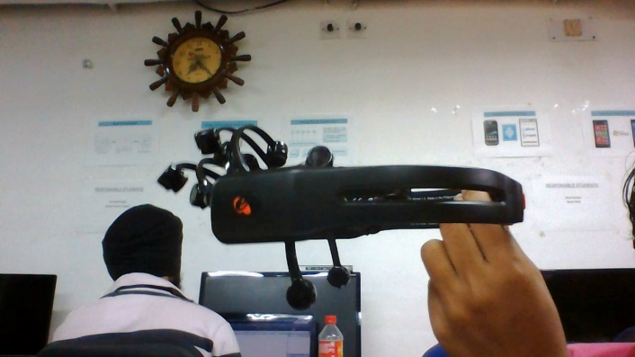
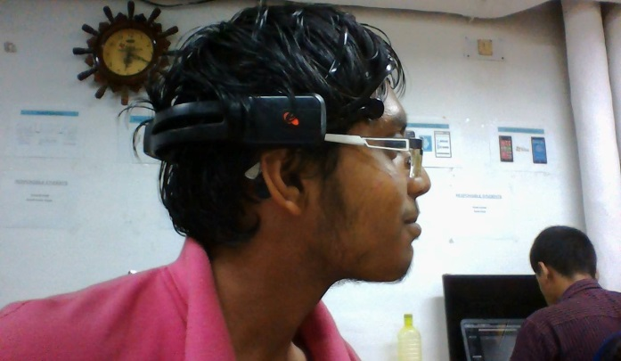
Case3: Data Acquisition Using Emotiv and Classification
An experimental cue was set up in which for first 20 secs the person had to imagine a particular task say right hand movement. This was followed by a 5 sec delay and then for next 20 secs subject had to imagine another task say right leg movement.
Fig9: Data Acquisition using Emotive

Slide 33
Five trail has been done for each Subject The data was then passed to a band pass filter(4Hz-40Hz) an processed according in the similar way as was done using standard datasets.
DWT is used for Feature extraction and the number of decomposition levels are chosen to be 4 and one final approximation.
Wavelet coefficient is computed using db4

